Slide 1
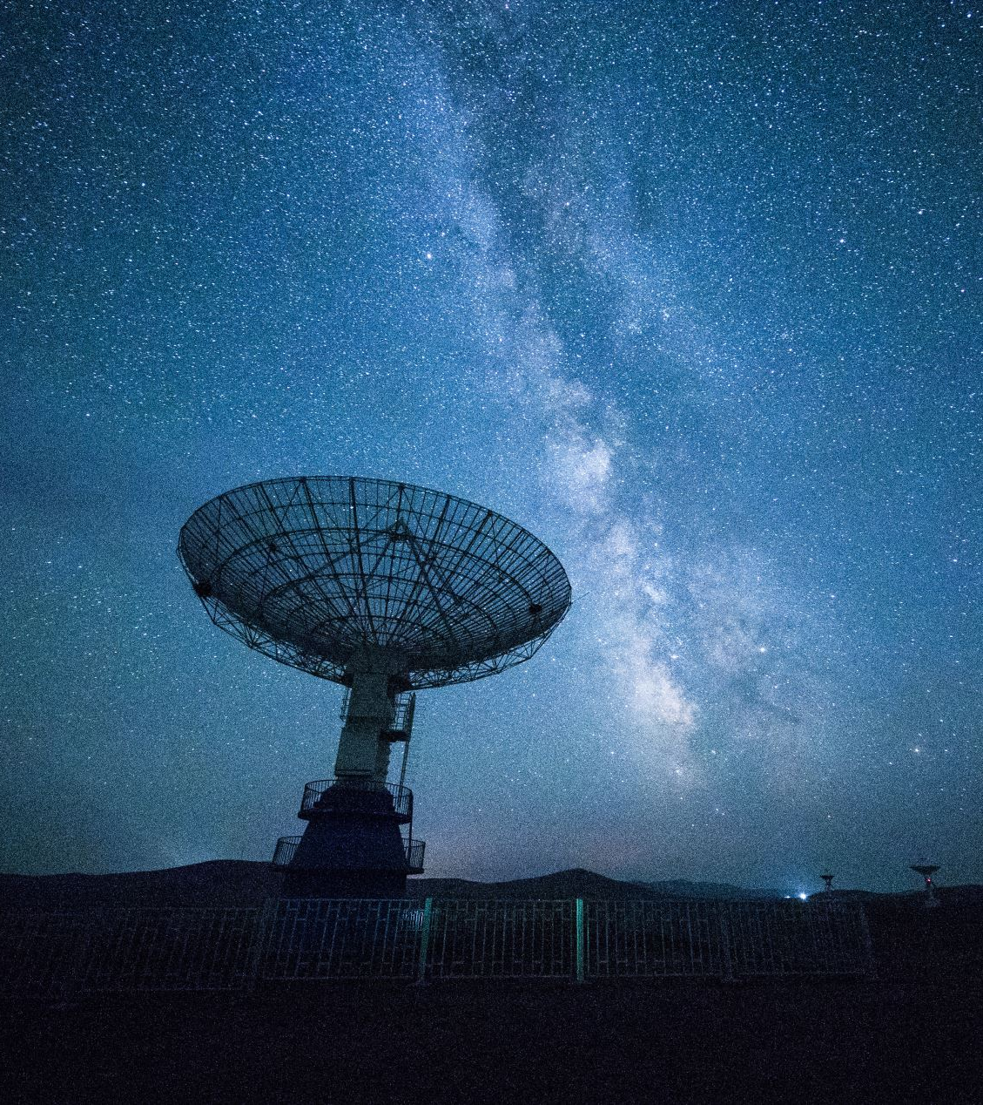


Machine Learning For Radio Source Host Galaxy Classification
Add date + year
Praisegod Thutho Ndlovu
Supervisor: Dr Khadija El Bouchefry
08/01/2021

Slide 2
Outline
AIM OF THE PROJECT
INTRODUCTION
MACHINE LEARNING (ML)
STAR FORMING GALAXY (SFG)
ACTIVE GALACTIC NUCLEI (AGN)
DATA
SLOAN DIGITAL SKY SURVEY
WIDE-FIELD INFRARED SURVEY EXPLORER
UNIFIED RADIO CATALOGUE
CLASSIFICATION
K-NEAREST NEIGHBOUR CLASSIFIER
RANDOM FOREST CLASSIFIER
RESULTS
CONCLUSION

Slide 3
Aim of the project
The aim of this work is to classify the host galaxies of radio sources using supervised machine learning algorithms (K-Nearest Neighbour & Random Forest).
Labelled multi-wavelength data (i.e. optical and infrared data) will be used to investigate the performance of supervised algorithms used for the radio sources classification.
The Optical data will be compiled from SDSS and infrared data will be queried from WISE.

Slide 4
INTRODUCTION: What is machine Learning ?
Machine Learning (ML) is the science of getting computers to learn and act like humans do, and improve their learning over time in autonomous fashion, by feeding them data and information in the form of observations and real-world interactions (Ivezi´c et al., 2019).
The application of Machine learning it is most useful to astronomers, it can process data faster than other techniques (Kremer et al., 2017).

Slide 5
What is machine Learning ?
Machine learning algorithm come in different flavors and can be grouped into three groups reinforced, supervised, and unsupervised techniques.
In this project we will use the supervised machine learning to classify host galaxies of radio sources.

Slide 6
What is machine Learning ?
There are two types of Supervised Learning techniques:
Regression
and Classification
There are also many different types of supervised learning algorithms, but in this project we will use
K-nearest neighbors(KNN)
and Random forests(RF).

Slide 7
Active galactic nuclei
Active galactic nuclei (AGNs) is a region at the center of the galaxy that has higher than normal luminosity i.e. It is brighter than the rest of the galaxy (Osterbrock & Ferland, 2006).
AGNs are not in the black hole it must be around supermassive black hole since there is no light exist in black hole (Kauffmann et al., 2003).
Supermassive black hole is surrounded by accretion disc (the structure composed of gas, dust orbiting around), since the accretion disc is rotating, as it start to heat up becoming hot it shine more brightly than the rest of the galaxy, then it create jets that fire out particle approximately with speed of light (Kauffmann et al., 2003).

Slide 8
Star Forming Galaxies
Star formation is the process by which dense regions within molecular clouds in star-forming regions, collapse and form stars (Tacconi et al., 2010).
As the cloud collapses, the material at the center start to heat up, it is this hot core at the heart of the collapsing cloud that will one day become the star (Tacconi et al., 2010).
Not all of this materials end up being part of the star, the remaining dust may become asteroids, planets, comets or it may remain as a dust (Guo et al., 2012).

Slide 9
DATA
The data used in this project contains different wavelengths in order to better train the machine learning algorithms:
Optical data from SDSS and
infrared data from WISE.

Slide 10
The Unified Radio Catalogue
This project used data from the Unified Radio Catalogue (URC, Kimball, 2014).
The URC combined sources were detected by:
Green bank 6 Centimetres (GB6),
Faint Images of the Radio Sky at 20 Centimetres (FIRST),
NRAO VLA Sky Survey 20 Centimetres (NVSS),
Westerbork Northern Sky Survey 92 Centimetres (WENSS),
and optical data from Sloan Digital Sky Survey (SDSS).

Slide 11
The Unified Radio Catalogue (cont)
The unified radio catalogue contain 2 866 856 sources
One third of its data has been detected optically (by SDSS)
More than 160,000 sources detected at 20 cm,
The catalogue matches FIRST with SDSS DR9 which overlap almost completely.

Slide 12
Cross matching URC and ALLWISE
Topcat was used to cross match the URC (2 866 856 sources) with AllWISE (747 634 026 sources).
Then 402 871 URC sources have been identified in ALLWISE,
The matched URC and ALLWISE contains:
5 677 SFGs
and 4 134 AGNs

Slide 13
Classification
We have applied the supervised machine learning algorithms (KNN & RF) to classify the sources between SFGs & AGNs.
Two useful concepts in object classification are the recall and precision

Slide 14


Recall and Precision
Recall indicates how good the classifier is at minimizing false negatives. A low recall for an individual class would indicate it is often misclassified as another class (Rahman et al., 2015).
Precision indicate how good the classifier is at identifying true positives(TP). A low precision for an individual class would indicate a low fraction of positive identifications (Rahman et al., 2015).

Slide 15
K-Nearest Neighbors Classifier
K-nearest Neighbors algorithm is used to assign a data point to clusters based on similarity measurement.
The steps that we are following when writing a k-means algorithm are:
We choose k-Nearest Neighbour
We calculate the distance of the nearest neighbour
Sort the distance and determine nearest neighbour based on the k-th minimum distance
Among these k-Nearest Neighbour, count the number of the data points in each category
Assign the new data points to that category for which the number of the neighbour is maximum
Now our model is ready (Wang, 2011).

Slide 16

K-Nearest Neighbors Classifier (cont)
We derive a plot between error rate and K denoting values in a defined range. Then choose the K-value having a minimum error rate (Polsterer et al., 2013).
We can also derive a plot of Accurace vs K-values. Then choose the K-value having a maximum accuracy (Borne, 2013).
To calculate the distance between test samples and trained data values, we will use Euclidean distance (Hastie et al., 2009).
.

Slide 17
Random Forest Classifier
Random Forest is a learning method that operates by constructing multiple decision trees.
The steps showing how random forest works are:
Start with the selection of random samples from a given dataset.
This algorithm will construct a decision tree for every sample. Then it will get the prediction result from every decision tree.
Voting will be performed for every predicted result.
Select the most voted prediction result as the final prediction result (Gao et al., 2009).

Slide 18
SFG and AGN classification using KNNC and RFC
Classification of the sources has been done using RFC and KNNC.
The input parameters were constructed using the SDSS and WISE magnitudes for both KNN and RF algorithms:
g, r, i, z, W1, W2, W3, W4, J, H, K, u-g, g-r, r-i, i-z, W1-W2, W2-W3, W3-W4, J-H, H-K, W1-J, W2-H, W3-K .

Slide 19
SFG and AGN classification using KNNC and RFC
Both algorithms (KNN and RF) are trained with 90% of the data, which contain 8 829 objects (5 111 SFGs and 3 718 AGNs)
And used 10% for testing our algorithm, which contain 982 objects (566 SFGs and 416 AGNs)
The predicted numbers of SFGs and AGNs are presented in the following slides.

Slide 20
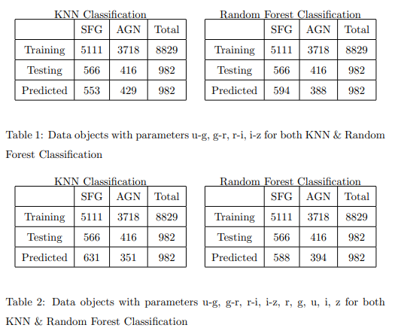
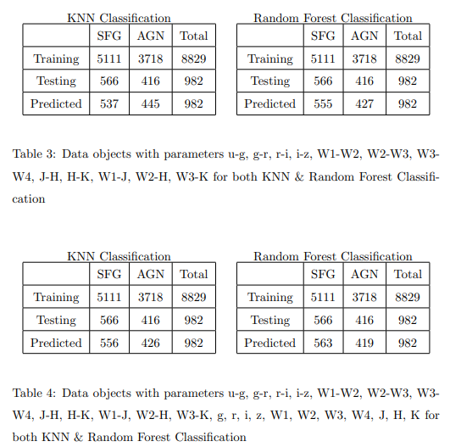

Slide 21
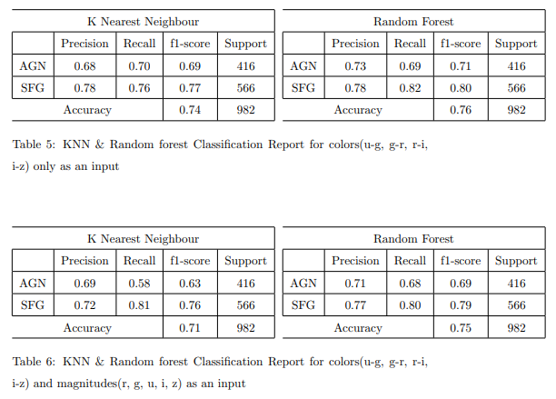
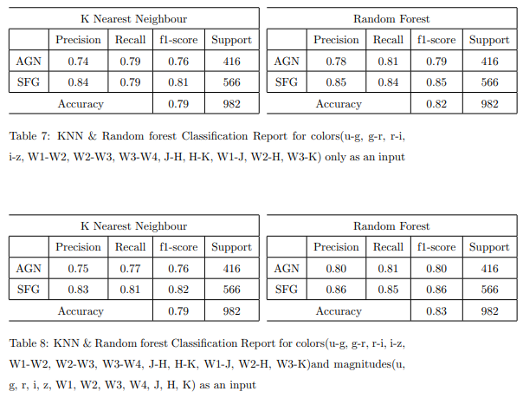

Slide 22
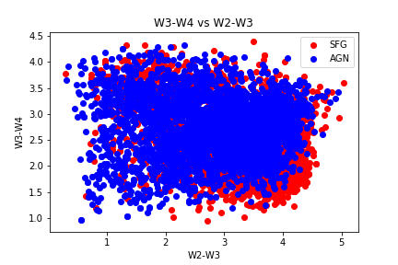
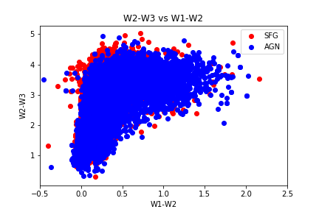
Color vs color diagram before classification

Slide 23
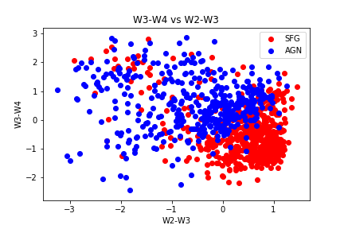
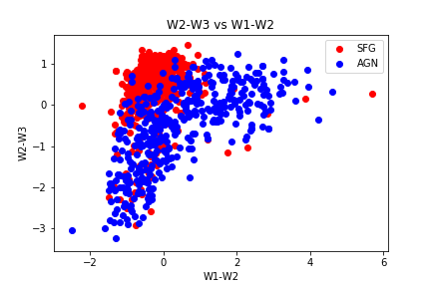
Color vs color diagram after classification

Slide 24
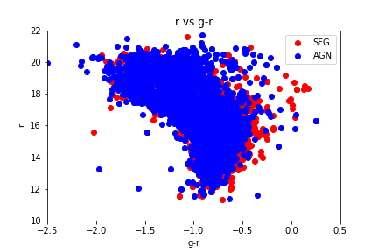
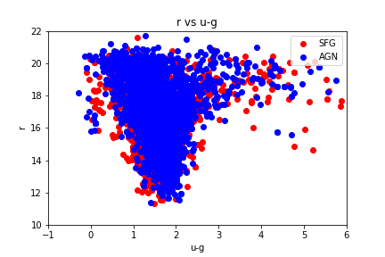
Magnitude vs color before classification

Slide 25
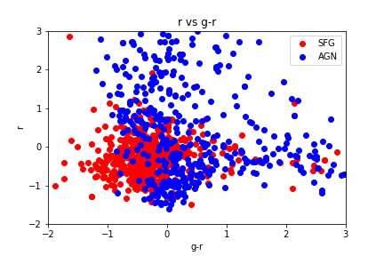
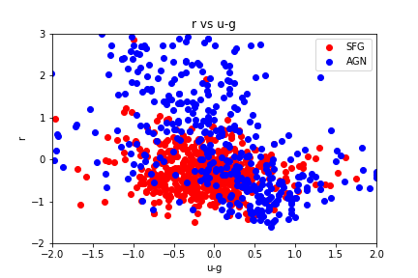
Magnitude vs color after classification

Slide 26
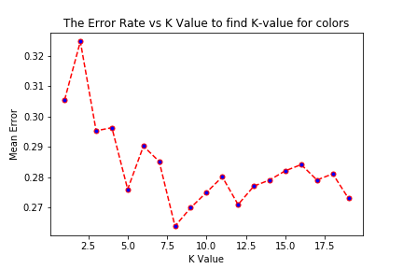
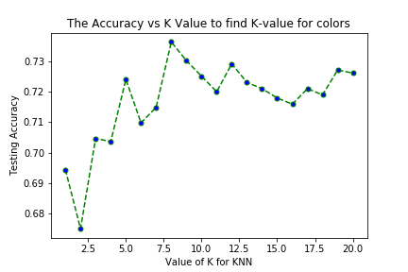
Choosing the value of K in KNN

Slide 27
Conclusion
The Random forest algorithm’s performance is better than the KNN algorithm.
Both Random forest and KNN are able to identify SFG with a higher accuracy (or more SFG), irrespective of the choice of the parameters.

Slide 28
Conclusion (cont)
Both Random forest and KNN algorithms perform better with more attributes, they have shown better results when both the magnitude and color parameters have been supplied as opposed to the case where only one of them (magnitude or color) is used.

Slide 29
Conclusion (cont)
Random forest is the algorithm that performed best compared to KNN.
To improve the accuracy of both classifiers, more parameters will be explored in future work.

Slide 30
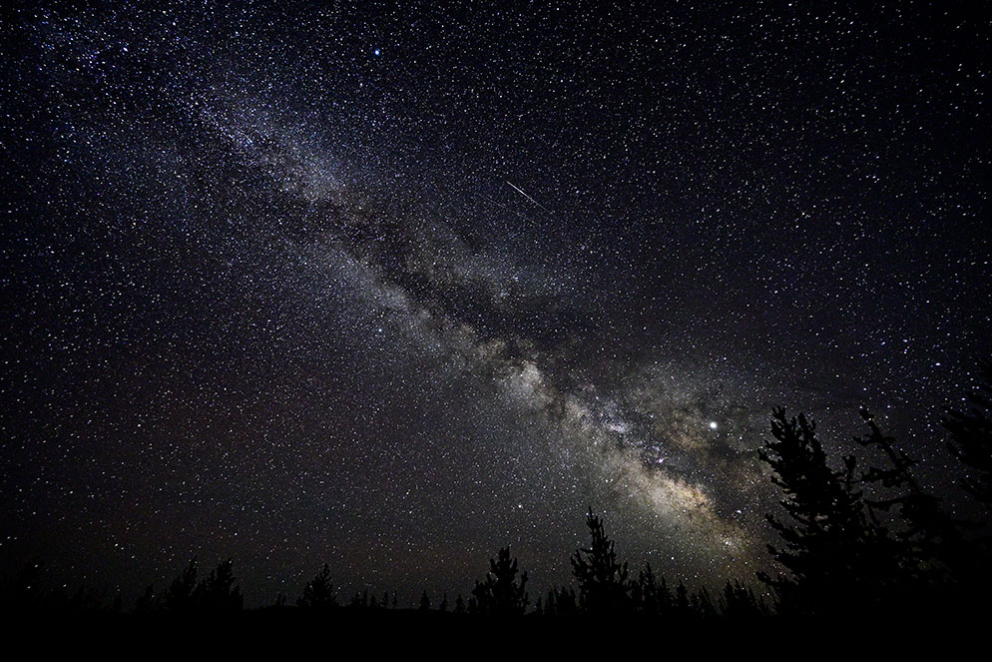
THANK YOU!!!

